Slide 1
Cross-Platform Mobile Development
Winston Gubantes
Xamarin Developer
Gluon Consulting

Slide 2



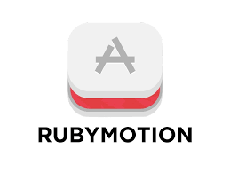







Cross-Platform Mobile Development Tools

Slide 3
Cross-Platform Mobile Development Languages
C++
Qt
Javacript
Cordova / Phonegap
Nativescript
C#
Xamarin
IFactor
Lua
Ruby
Corona
Rubymotion
ReactNative
Kony
Appcellerator

Slide 4
The Big 3
Three of the most popular Cross-Platform Mobile Development tools.

Slide 5
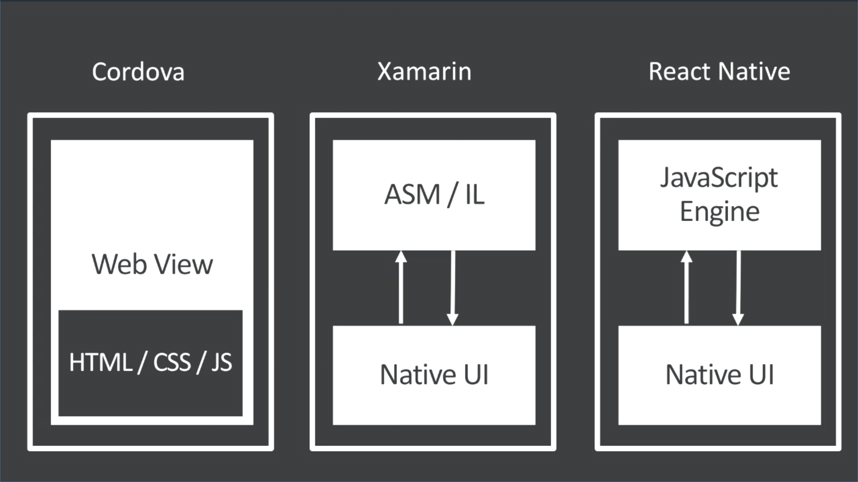
Build Build Build

Slide 6
Demo

Slide 7

Myth Busters
Cross-platform app is not native

Slide 8

Myth Busters
Cross-platform app is slow

Slide 9

Myth Busters
Cross-platform has limited access to native features

Slide 10

Myth Busters
Cross-platform app is bloated

Slide 11

Commonly Ask Questions
Should I develop an App for iOS or Android first?

Slide 12

Commonly Ask Questions
Where is the best place to go if I get stuck into something?

Slide 13
Demo
Xamarin.Forms

Slide 14

Tips and Tricks
Xamarin.Forms

Slide 15

It's a Disastah!
Disastrous Mistakes for Cross-Platform Mobile Development

Slide 16
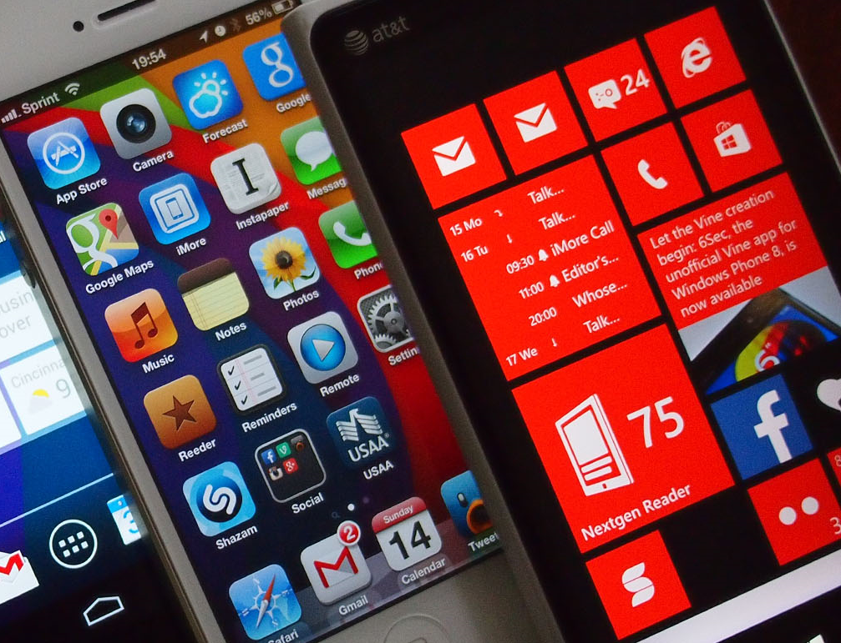
Overemphasize One Platform

Slide 17
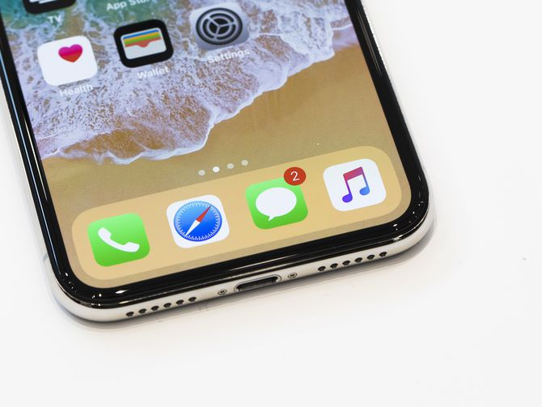
Not explicitly identifying all target devices and OS versions

Slide 18

Ignoring memory management (e.g. unsubscribing from all events)

Slide 19

Ignore Logging

Slide 20



